Slide 1
The Author-topic model for authors and Documents
Team Doctrina Apparatus

Slide 2
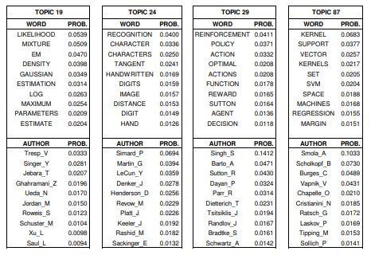
Author-topic model
Introduction
This model provides simple probabilistic model for exploring the relationships between authors, documents, topics and words.
Topic is defined as probability distribution over words and is discovered automatically with unsupervised learning.
At the same time, author’s interest to that topic is simultaneously quantified.

Slide 3
Topic model and author model
For author model, the interests of authors are directly modeled with probability distributions over words.
For topic model,
Author: Ngok-Chao_H
WORD | PROB.
machine | 0.0823
learning | 0.0497
upsupervised | 0.0234
supervised | 0.0226
python | 0.0224
C++ | 0.0166
natural | 0.0151
language | 0.0134
processing | 0.0131
continuous | 0.0121

Slide 4
Model description

Slide 5
Parameter estimation by Gibbs sampling
Baysian Method
Markov Chain
1000 iteration

